Slide 1
Habot Hiring Project
Junior Google & DevOps Engineer

Slide 2
Introduction
Name: Kavitha Kumari
Email: kavithakumari351@gmail.com
Project repository: https://github.com/kavitha351/habot-assesment.git

Slide 3
About Project
Designed a secure Google Google infrastructure using Terraform, implemented a fail-closed CI/CD pipeline using Github Actions, and created strict Django REST framework validation for student onboarding data.
React
↓
Django REST API
↓
Google Storage
↓
BigQuery

Slide 4
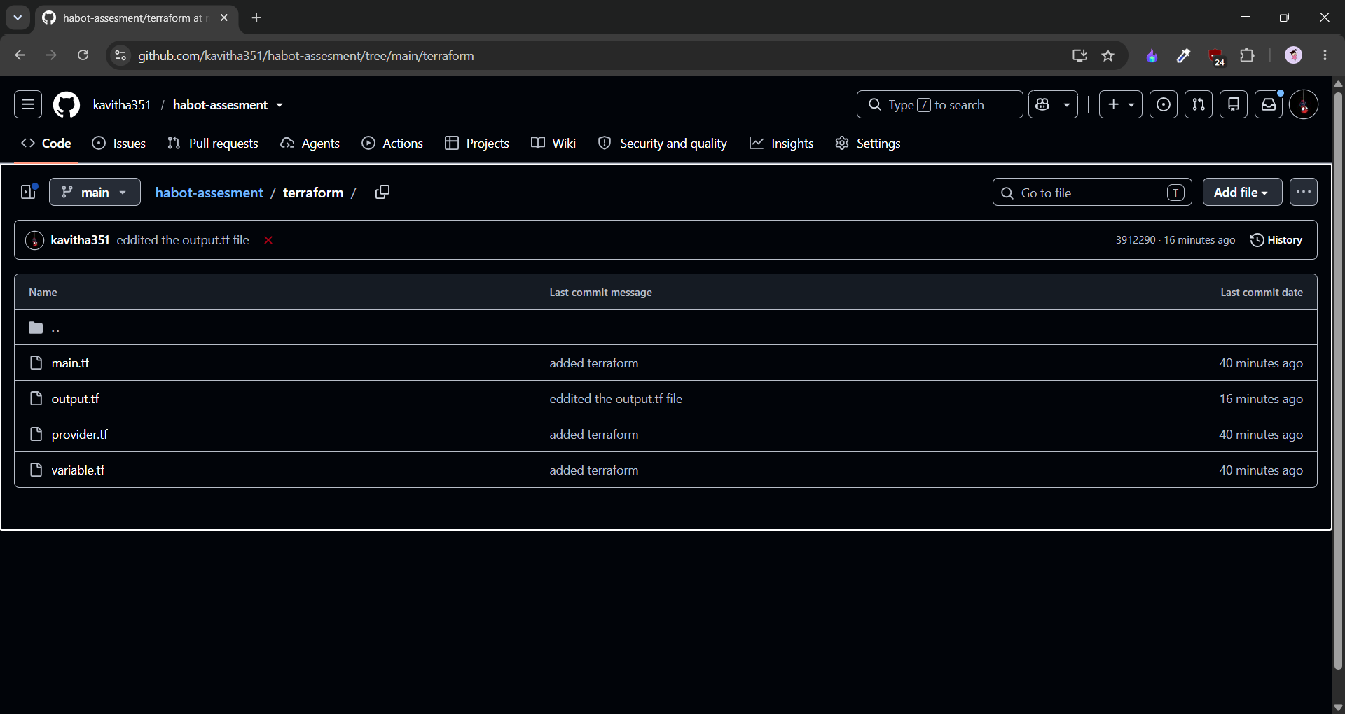
Terraform
Terraform
↓
Google Cloud Storage
(Raw Landing Bucket)
↓
BigQuery Dataset
↓
IAM Policies
(Least Privilege)

Slide 5
Security features
🪣 Uniform Bucket Level Access
🔒 Public Access Prevention
👤 IAM Least Privilege
📊 BigQuery Read-only Access
🛡 Terraform Validation

Slide 6
Ci/cd pipeline
Developer
↓
GitHub
↓
GitHub Actions
↓
Terraform Format
↓
Terraform Validate
↓
Python Lint
↓
Secret Scan
↓
PASS / FAIL

Slide 7
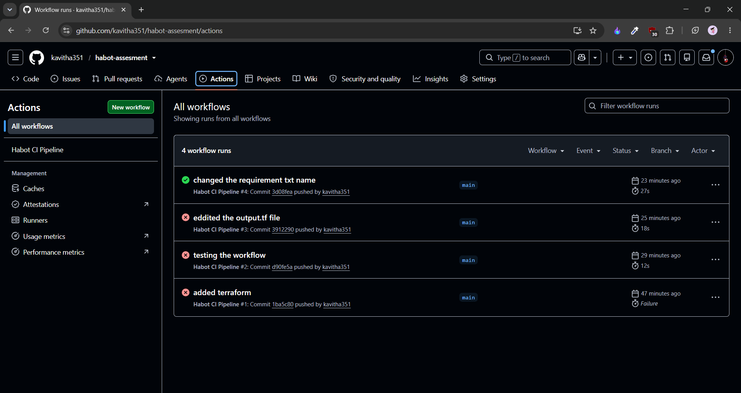
Workflow

Slide 8
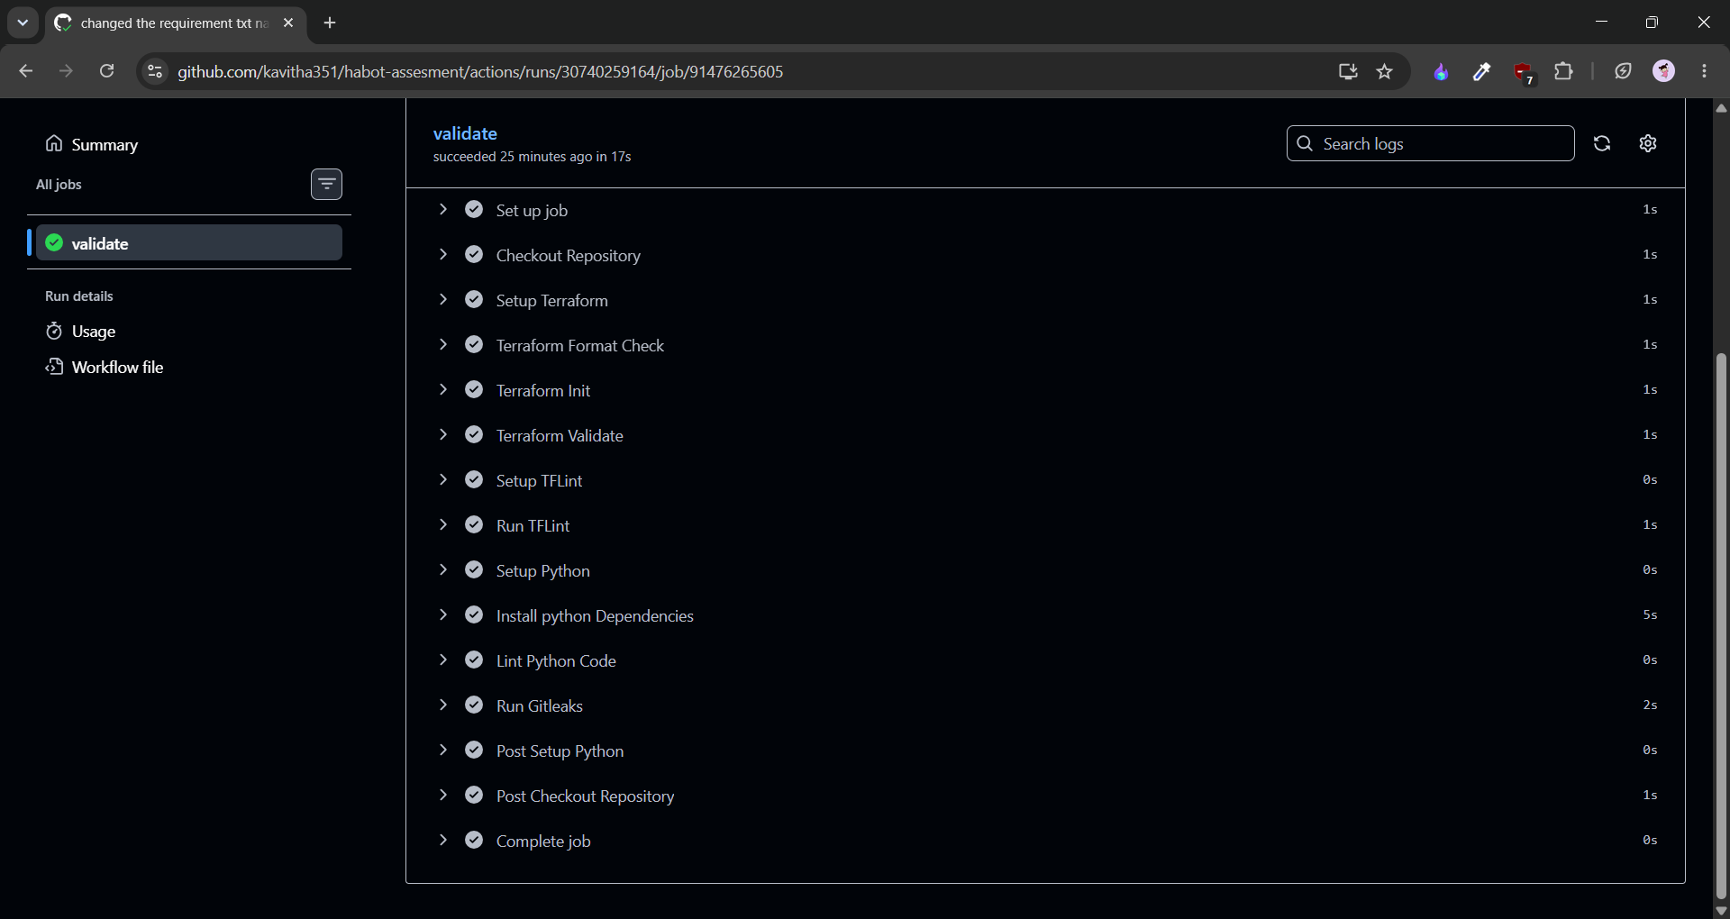
Workflow Steps

Slide 9
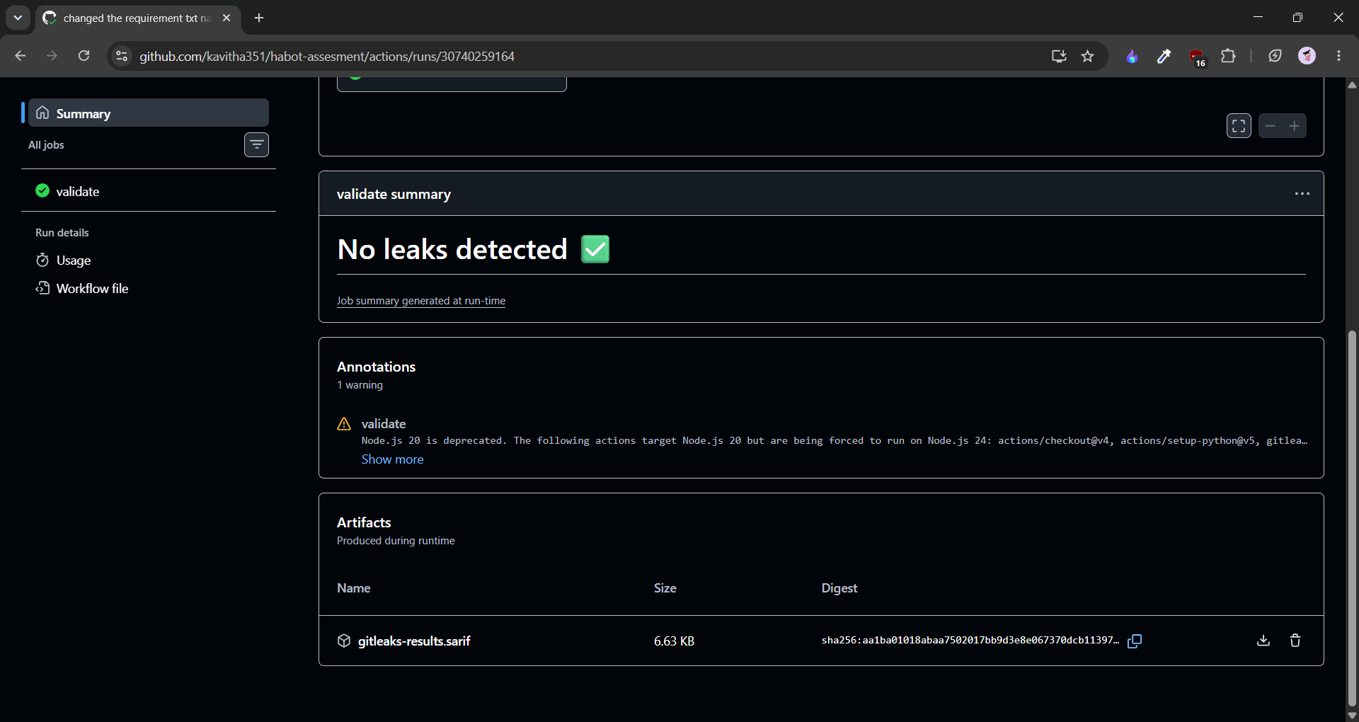
Workflow result Successful execution of the CI/CD pipeline after all validation checks passed.

Slide 10
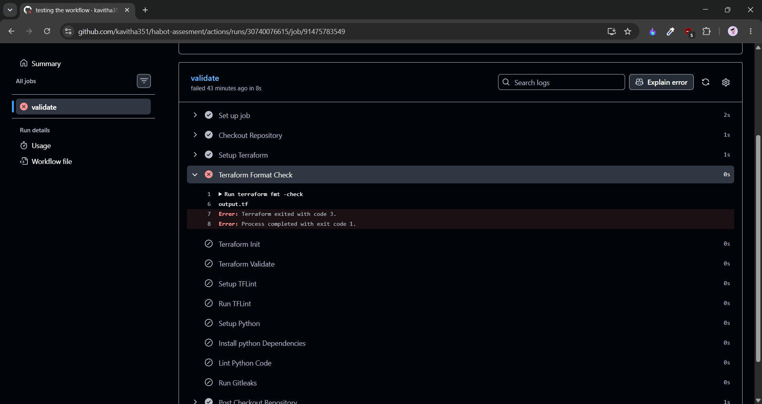
Workflow fail scenario Pipeline stopped automatically when Terraform formatting validation failed.

Slide 11
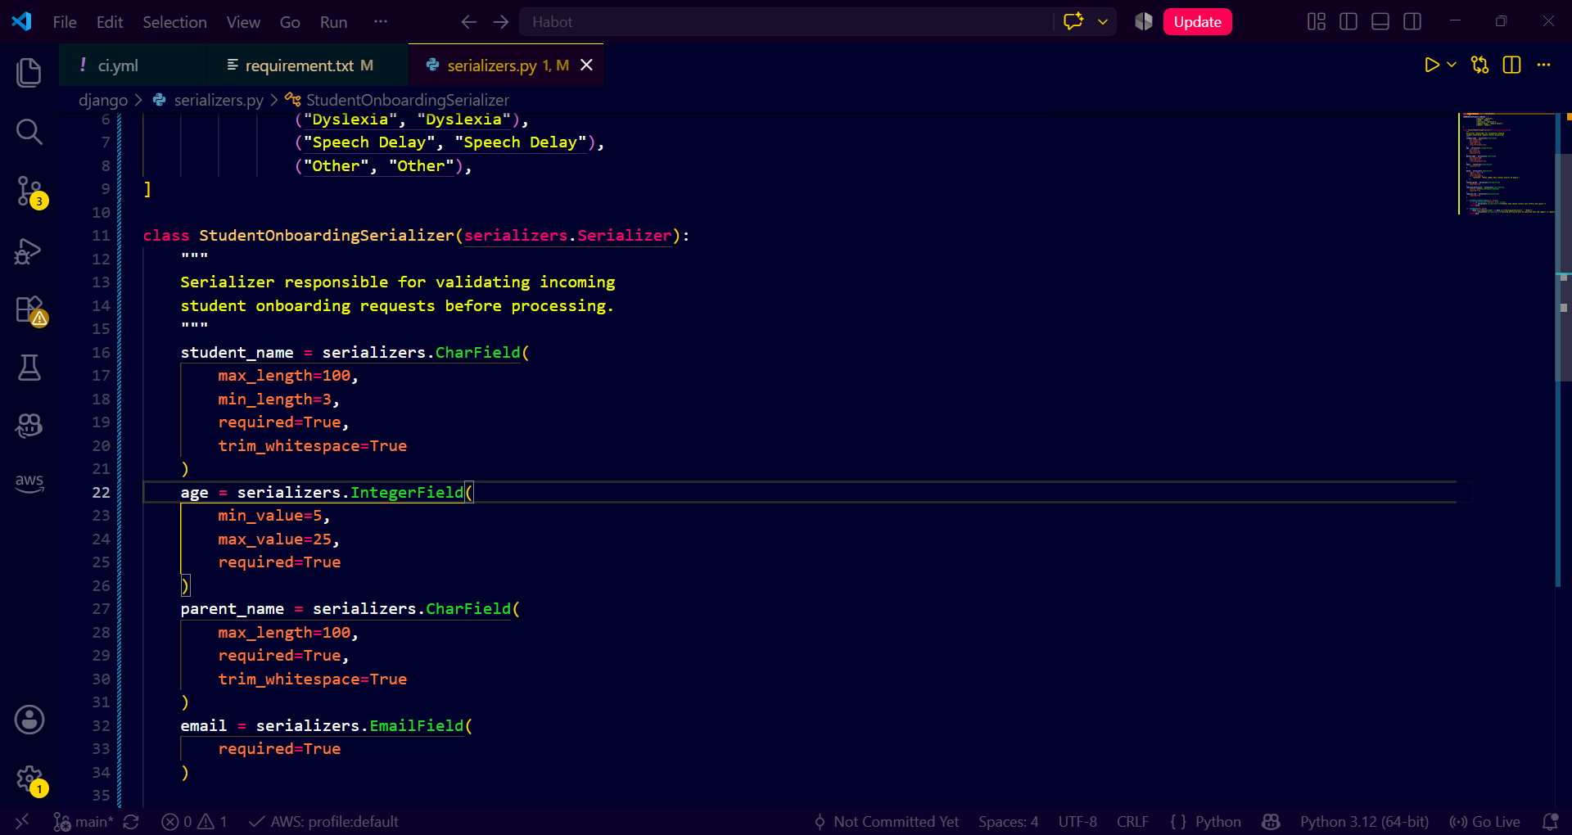
Django
Studentonboardingserializer
Field-level validation
Business rule validation

Slide 12
DCYN (binary Yes/No) logic library
Input Field | Rule | Output
Email valid? | Email format check | Yes / No
Phone valid? | 10 digits | Yes / No
Age valid? | Between 5 and 25 | Yes / No
LSA requested? | Boolean | Yes / No
Consent given? | Boolean | Yes / No

Slide 13
Decisions
Decision | Reason
Terraform | Infrastructure as Code
Variables | Avoid hardcoding
IAM | Least Privilege
Github Actions | Automated validation
Gitleaks | Secret detection
Serializer | Strict data validation

Slide 14
challenges
Understanding GCP resource provisioning with Terraform
Building a fail-closed CI/CD pipeline
Designing strict serializer validation
Applying IAM using least-privilege principles

Slide 15
outcome
Provisioned secure infrastructure using Terraform
Implemented automated CI/CD validation
Built reusable request validation
Strengthened understanding of Google security and automation

Slide 16
Thank you

